Slide 1
Rotor Hub And Pitch System
Group Members :
Dhruvin Kakdiya
Adharsh Pappinisseri Veedu
Muthu Thirunavukarasu
Syed Mohammed Sikandar
Week number : 08
Date: 18/11/2025
Supervisor: Prof. Peter Quell

Slide 2
List of contents
Bolt calculations
Alternative source for pitch System
Lubrication System
CAD Model of Blade Bearing
Dhruvin Kakdiya

Slide 3
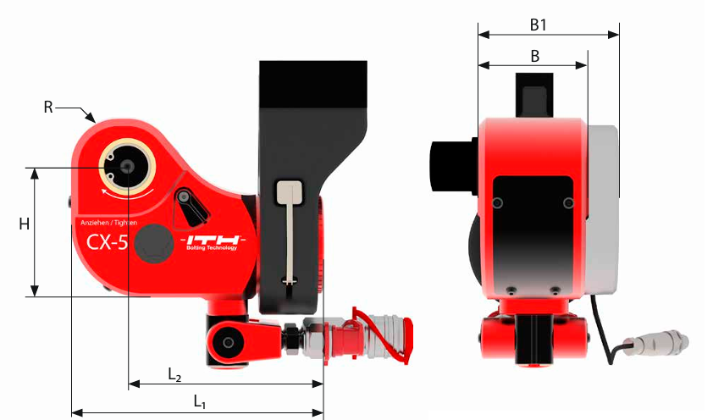
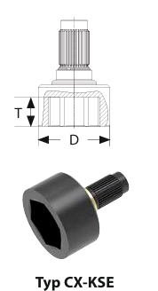
Bolt calculations
Hydraulic Torque wrench for M36 bolts
Tool specification
ITH TYPE CX5
SW 55
D= 87 mm
T= 36 MM
[1] ITH
Dhruvin Kakdiya

Slide 4
No. of bolts in outer ring = πd / D of machine = 122
BCD d = 3400 MM
D of machine = 87
Dhruvin Kakdiya

Slide 5
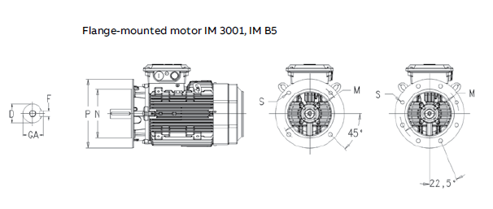
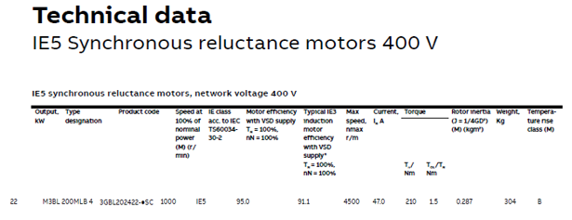
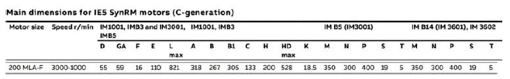
Alternative source for pitch System
Motor:
[2]
Dhruvin Kakdiya

Slide 6
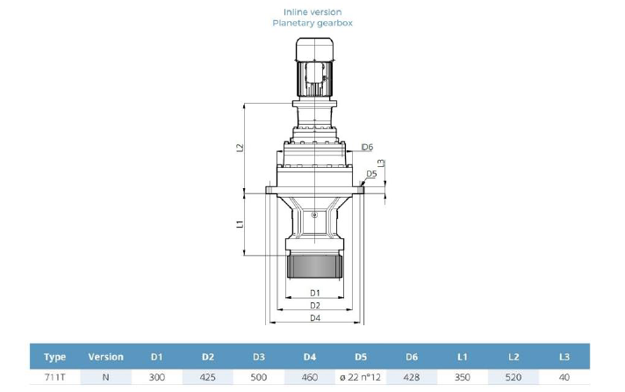
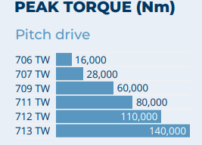
Gear box:
Required peak pinion torque: 61.5 KNm . So we opt 711 TW with 80,000 Nm range
3 stage planetary
[3]
Dhruvin Kakdiya

Slide 7
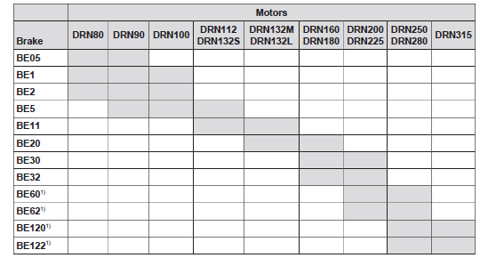
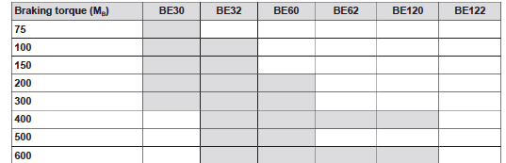
Brake:
𝑀𝐵=Maximum required brake torque = 108 Nm
Considering the frame size of the selected motor 200𝑀 and the required brake torque, we chose the 𝐵𝐸30 brake from 𝑆𝐸𝑊−𝐸𝑈𝑅𝑂𝐷𝑅𝐼𝑉𝐸.
Dhruvin Kakdiya

Slide 8
Lubrication System
A lubrication system is designed to deliver the correct amount of lubricant (usually grease or oil) to moving machine parts. Its primary purpose is to reduce friction, minimize wear, prevent corrosion, and remove contaminants from contact surfaces.
Automatic lubrication is selected for this turbine because it provides consistent, controlled, and reliable grease delivery to the pitch bearing
Feature | Manual Lubrication | Automatic Lubrication
Lubrication Frequency | Periodic (scheduled stops) | Continuous or timed intervals
Accuracy of Grease dosage | Low – operator dependent | High – controlled & consistent
Downtime | Requires stopping turbine | Can operate while running
Reliability | Medium | Very High
Cost | Low initial cost | Higher initial cost
Dhruvin Kakdiya

Slide 9
Types of Automatic Lubrication systems
Type | How it works? | Advantages | Limitations
Progressive Distributor system | One pump → primary metering block → secondary blocks → grease flows through a fixed sequence | High reliability, blockage detection, equal distribution, good for large bearings | Entire system stops if one outlet blocks (but gives alarm)
Injector system | Each injector delivers a metered shot independently | Can supply different outputs per point | Injectors require pressure reset cycles; more complex to maintain
Progressive lubrication systems are preferred because they offer the most reliable and controlled grease delivery. Each lubrication point receives a precisely metered amount of grease in a fixed sequence, ensuring uniform distribution across all bearing rows. Blockages are immediately detected because the metering pistons stop in sequence, allowing early fault identification and preventing bearing damage.
Dhruvin Kakdiya

Slide 10

Grease Volume Calculation
Amount of Grease Required = Volume of 3 Raceway − (Volume of Roller × Number of Rollers)
Parameters:
Raceway outer diameter $D_{o}=3229 \text{mm}=3.229 \text{m}$
Raceway inner diameter $D_{i}=3169 \text{mm}=3.169 \text{m}$
Width $B=61.5 \text{mm}=0.0615 \text{m}$
Roller diameter = 60 mm → radius = 30 mm
Roller length assumed = 60 mm
Number of rollers = 145
Grease density = 0.90 kg/L
Fill fraction = 80%
Relubrication fraction = 50% per year
Dhruvin Kakdiya

Slide 11

Raceway volume (one row)
V =π($R_{o}^{2}−R_{i}^{2}$)B
$$R_{o}=1.6145, R_{i}=1.5845 \text{m}$$
$$R_{o}^{2}−R_{i}^{2}=0.0955 {\text{m}}^{2}$$
For Three Raceway,
V$=π×0.0955×0.0615=0.01854{ \text{m}}^{3}=18.54 \text{L}$
Vraceway,total​=3×18.54=55.62 L
Dhruvin Kakdiya

Slide 12


Annual Grease Requirement
We convert grease volume (liters) into mass (kg) because grease is purchased, applied, measured, and calculated in mass, and density differences make mass the only reliable engineering unit.
Mass=Volume×Density
At 80% fill the mass in the raceway is,
Annual Relub (50% of filled mass)
Pitch bearing gear: Requires 5.00 kg/year
Total Annual Requirement
Mass $=31.03 \text{L}×0.90 \frac{\text{kg}}{\text{L}}$$=27.93 Kg$
27.93 kg×0.80=22.34 kg
$$22.34 \text{kg}×0.50=11.17 kg/year$$
(11.17 kg+5.00 kg)=16.17 kg/year
Dhruvin Kakdiya

Slide 13


Grease Volume for Maintenance Interval
For a 6-month operational period
Monthly consumption:
Grease for 6 months (per bearing)
For 3 identical bearings (total)
16.17 kg /12 = 1.348 kg/month
$1.348×6=8.08$ kg
8.08 kg$×3=\text{24.24}$kg
Dhruvin Kakdiya

Slide 14
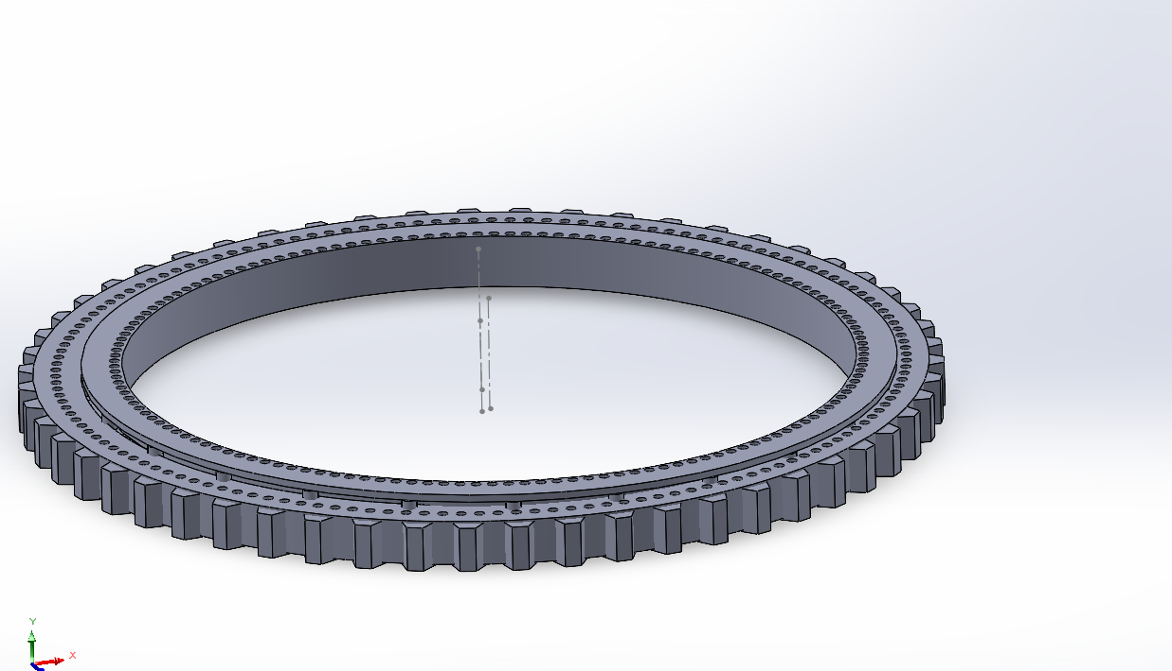
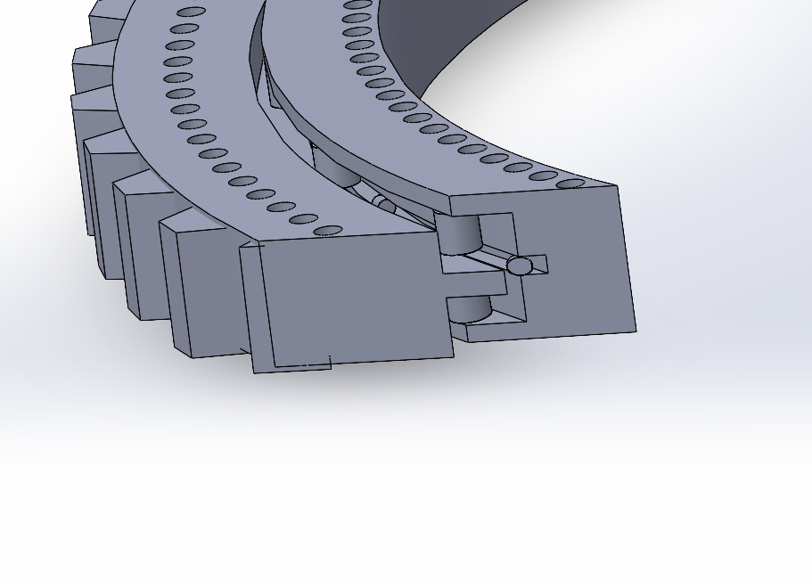
CAD Model of Blade Bearing
Sectional view
Orthographic view
(8) Fig. : Outer ring rotating triple row roller bearing (Assembly)
Dhruvin Kakdiya

Slide 15
Bibliography
ITH. (n.d.). ITH Hydraulic Torque Wrenches Catalog. Retrieved November 08, 2025, from www.ITH.de/schraubwerkzeuge/hydraulische-drehmomentschrauber (12.11.2025)
https://www.bonfiglioli.com/_default_upload_bucket/TR_CAT_WIND_STD_ENG_R05_1.pdf?_gl=1*st0uf6*_up*MQ..*_ga*MTkwODc0NTgyMS4xNzYzMTE5NzE0*_ga_B0519ZEPFF*czE3NjMxMTk3MTQkbzEkZzAkdDE3NjMxMTk3MTQkajYwJGwwJGgw (14.11.2025)
Low voltage motor catalog: Synchronous reluctance motors, 9AKK107743 EN 09-2023 (14.11.2025)
https://download.sew-eurodrive.com/download/pdf/22134204_G07.pdf(14.11.2025)
SKF — Determining grease quantities & general bearing lubrication guidance [14.11.25]
https://www.skf.com/group/industries/wind-energy/operation-and-maintenance/windlub [15.11.25]
https://www.machinerylubrication.com/Read/29285/manual-automatic-lubrication [15.11.25]
https://www.skf.com/binaries/pub12/Images/0901d1968019d1ed-17099EN_SKF_Automatic_Lubricators_tcm_12-66465.pdf [15.11.25]
Fig. : Outer ring rotating triple row roller bearing (Assembly)

